Slide 1

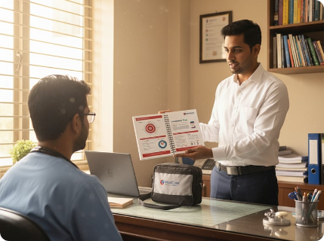

L'ORÉAL
SUSTAINABILITY CHALLENGE 2026
TRACK: SALES & MEDICAL
ZERO-WASTE SALES ENGINE
STRATEGIC PITCH DOCUMENT
PharmaSmart: Precision Detailing & Zero-Waste Sales Engine
ZERO WASTE
Optimizing L'Oréal Dermatological Beauty (LDB) field operations using Predictive Sample Allocation, Digital E-Detailing, and ITIL SLA Incident Logistics.
SUBMITTED & PRESENTED BY
Gnaneshwari Mahimaluru
Education PGDM Analytics
IT Ops Background Accenture (ITIL SLAs)
Healthcare Mktg CARE Hospitals
Digital E-Detailing Platform
Presented By: [Your Name] • PGDM Business Analytics | Ex-Accenture | CARE Hospitals
Problem Statement: Selling Smarter • Building a High-Impact Sales Engine with Reduced Waste

Slide 2
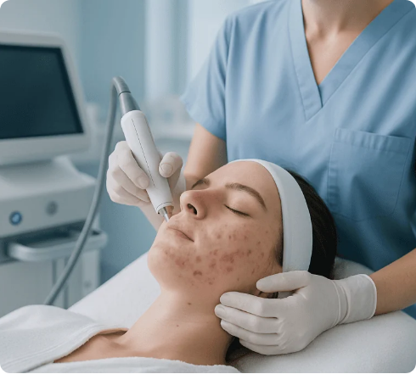
PROBLEM IDENTIFICATION & CONTEXT
INDUSTRY BOTTLENECKS
Traditional Dermocosmetic Sales Waste Channels
Key inefficiencies across field reps, sample kits, and doctor detailing routes
1. Uncalibrated Sample Discards
25-30% Scrap Rate
Medical reps carry generic product volumes. Mismatched clinic demographics cause samples to expire in field bags or doctor storage rooms.
2. Single-Use Print Materials
High Carbon & Cost
Heavy gloss visual aids, paper prescribing leaflets, and cardboard display stands are immediately discarded without actionable reading analytics.
3. Route & SLA Friction
Unoptimized Miles
FIELD FRICTION
Static visit schedules cause unnecessary vehicle emissions and delayed responses to urgent doctor sample replenishment requests.
Static Supply Chains Lead to Waste
Traditional rep push models dump uniform sample packs onto doctors regardless of prescription rate.
L'Oréal Sustainability Challenge 2026
Slide 2 of 5 • Problem Context

Slide 3

PROPOSED SOLUTION
SUSTAINABLE SALES ENGINE
The PharmaSmart High-Impact Sales Engine
Merging predictive analytics with ITIL service management for dermocosmetics
1
Predictive Sample Allocation (ML Engine)
Algorithms analyze doctor prescribing history & footfall to assign micro-targeted sample kits, stopping inventory expiry.
2
Interactive Cloud E-Detailing Platform
100% tablet detailing with doctor interest telemetry, replacing physical paper booklets and single-use display boxes.
SUSTAINABLE SUPPLY CHAIN
3
ITIL SLA Logistics & Dynamic Routing
CLOSED-LOOP ZERO-WASTE PROCESS FLOW
Adapting Accenture IT Service Management: treating sample dispatch delays as trackable SLA tickets to optimize field rep routes.
Prescribing Data
Predictive Demand
SLA Route Rep
L'Oréal Sustainability Challenge 2026
Slide 3 of 5 • Solution Framework

Slide 4
TECHNICAL ARCHITECTURE
TECH STACK
Leveraging Analytics & IT Service Background
Translating Accenture ITIL SLAs and Healthcare Marketing into L'Oréal Sales Ops
LAYER 01 • DATA CAPTURE
LAYER 02 • CORE INTELLIGENCE
LAYER 03 • OPERATIONS
Doctor Telemetry & CRM
Predictive Sample Engine
ITIL SLA Incident Logistics
•
Aggregates doctor prescribing patterns & clinic footfall.
•
PGDM Business Analytics Machine Learning algorithm.
•
Accenture-based SLA ticketing framework for sales reps.
•
Tracks digital visual aid dwell-time (CARE Hospitals strategy).
•
Forecasts sample kit requirements per zip code.
•
Triggers reorder alerts before product expiration dates.
•
Treats field stockouts & delays as trackable P1/P2 incidents.
•
Centralizes CRM data across La Roche-Posay & CeraVe.
•
Guarantees high rep field uptime & zero route wastage.
Candidate Experience Fit:
PGDM Analytics
Accenture IT Incident Management
CARE Hospitals Healthcare Strategy
L'Oréal Sustainability Challenge 2026
Slide 4 of 5 • Technical Architecture

Slide 5
IMPLEMENTATION & EXPECTED IMPACT
HIGH IMPACT KPIS
Quantifiable Business & Sustainability Outcomes
Directly aligning with L'Oréal "For the Future" 2030 sustainability commitments
-35%
100%
+25%
+18%
Sample Waste
Paperless Detailing
Rep SLA Efficiency
HCP Conversion
Via ML prescribing allocation
Eliminating print brochures
Via ITIL incident logistics
Data-driven doctor targeting
3-PHASE STRATEGIC ROLLOUT PLAN
Phase 1 (Months 1-3)
Phase 2 (Months 4-6)
Phase 3 (Months 7-12)
Audit sample waste & pilot e-detailing app in key hospital zones.
Deploy ML sample forecasting engine & ITIL SLA ticketing platform.
Scale across L'Oréal Dermatological Beauty (LDB) brands nationwide.
L'Oréal Sustainability Challenge 2026
Slide 5 of 5 • Implementation & Expected Impact

Slide 6



Image Sources
https://assets.zyrosite.com/cdn-cgi/image/format=auto,w=768,h=750,fit=crop/mP4MVZKJgyhev0ae/gemini_generated_image_ke4gw9ke4gw9ke4g-AQEexgW2RQfwgvbD.png
Source: strio.in
https://acibademinternational.com/wp-content/uploads/2026/06/acne-14402-JKuLXD-1024x683.webp
Source: acibademinternational.com
https://www.dhl.com/discover/content/dam/global-master/4-logistics-advice/ethical-and-green-logistics/dis0975--refresh-of-green-logistics-toolkit/Green_logistics_Implement_green_warehousing.webp
Source: www.dhl.com

